Slide 1
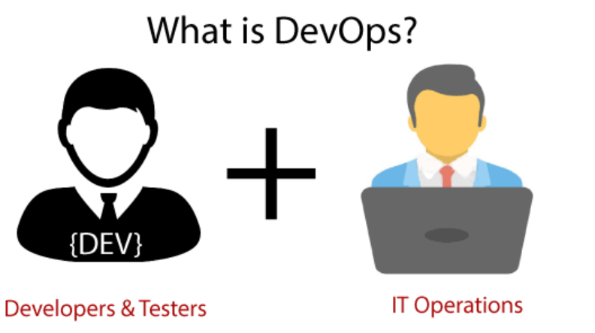
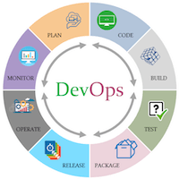
DevOps
DevOps consists of two words – Software Development and Operations
It is a culture to promote the development and operation process collectively
DevOps is a software development and IT operations process that helps to improve the collaboration between developers and operators by automating the Deployment, configuration, monitoring, and management of application
DevOps helps to increase organization speed to deliver applications and services
DevOps is all about the integration of the operations and development process.
With of help of DevOps, quality, and speed of the application delivery has improved to a great extent
DevOps is nothing but a practice or methodology of making "Developers" and "Operations" folks work together

Slide 2
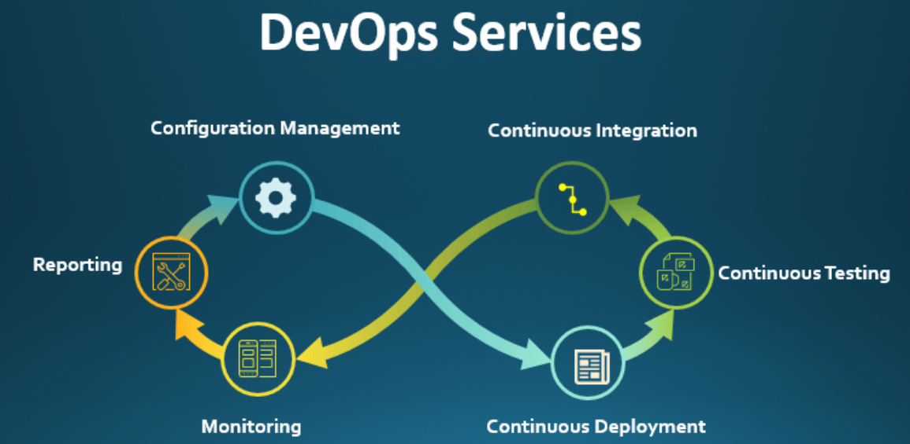
DevOps Main Services
Continuation Integration
Continuation Delivery
IT Security
Change Control
Backup and disaster Recovery Planning
Automating and Orchestrating entire process
Configuration of servers, Hardware and OS
Monitoring of servers

Slide 3
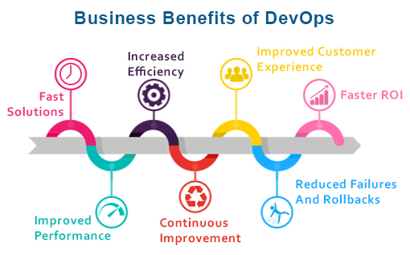
DevOps Advantages
DevOps is an excellent approach for quick development and deployment of applications
It responds faster to the market changes to improve business growth
DevOps escalate business profit by decreasing software delivery time and transportation costs
DevOps clears the descriptive process, which gives clarity on product development and delivery
It improves customer experience and satisfaction
DevOps simplifies collaboration and places all tools in the cloud for customers to access
DevOps means collective responsibility, which leads to better team engagement and productivity
Better resource utilization
Greater automation

Slide 4
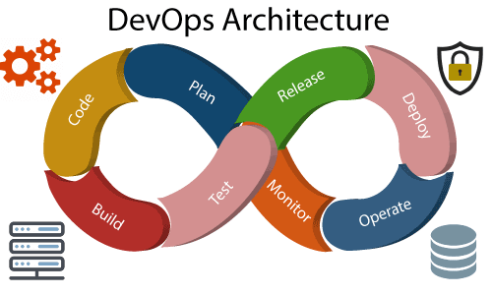
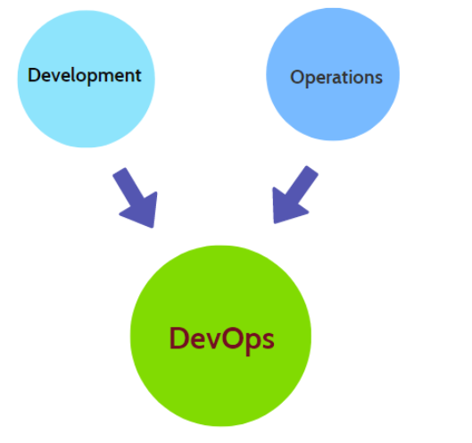
DevOps Architecture
DevOps architecture is used for the applications hosted on the cloud platform and large distributed applications
Agile Development is used in the DevOps architecture so that integration and delivery can be contiguous
DevOps enables the teams to change their shortcomings and increases productivity

Slide 5
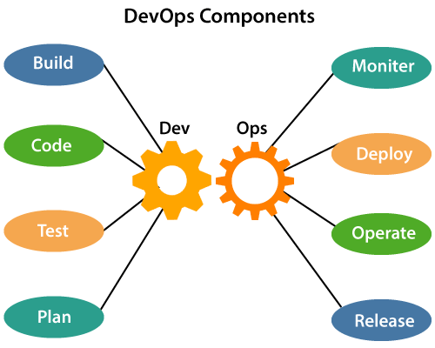
DevOps Components
Build: The build steps involves usage of cloud and sharing resources comes into picture. The build is dependent on user need and configured at beginning
Code: DevOps code involves development of code using git version controller. Which automatically notify changes.
Test: Automation testing used to reduce time for testing effort and reduce time for production code deployment. Also, scripts can be used to automate tests
Plan:DevOps uses Agile methodology for planning
Monitor: Continuous monitoring used to identify any risk of failure. The tool such as Splunk can be used for same
Deploy: DevOps supports automated deployment of software
Operate: The DevOps supports parallel in development and operations which increase the productivity and collaboration between teams
Release: Involves deployment of software into production

Slide 6
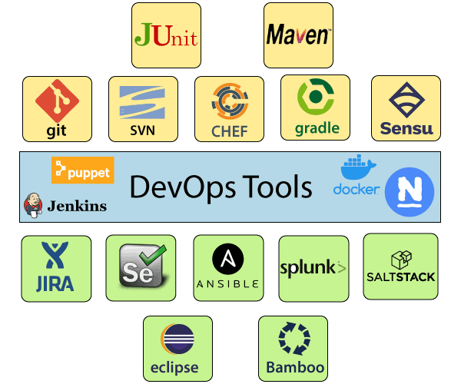
DevOps Tools

